Slide 1
Blue Team Trivia Maze
Elise Peterson, Zak Steele, Cord Rehn

Slide 2
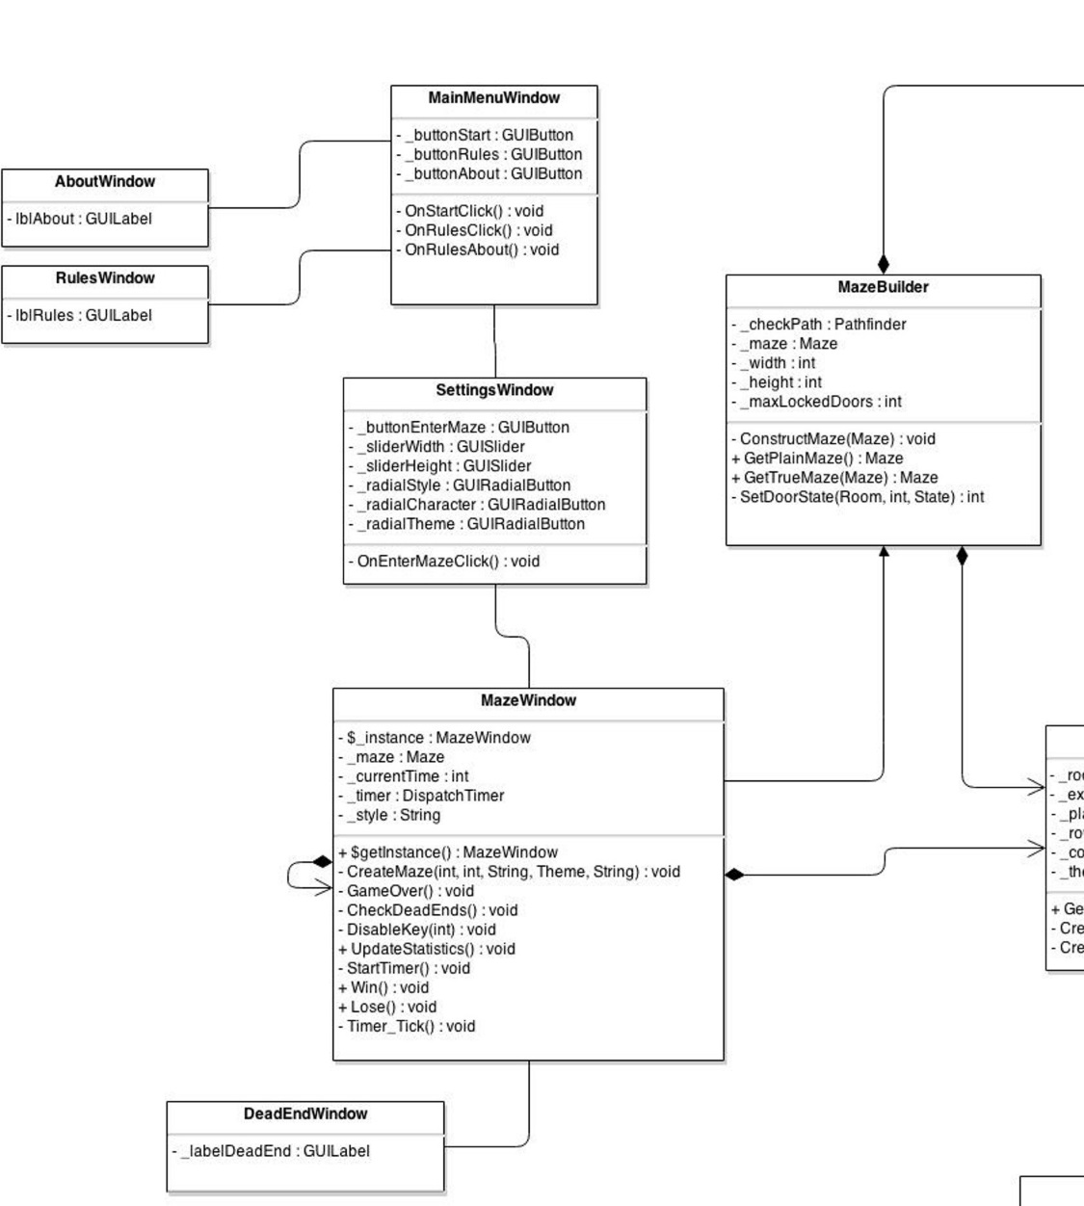
Class Diagram

Slide 3
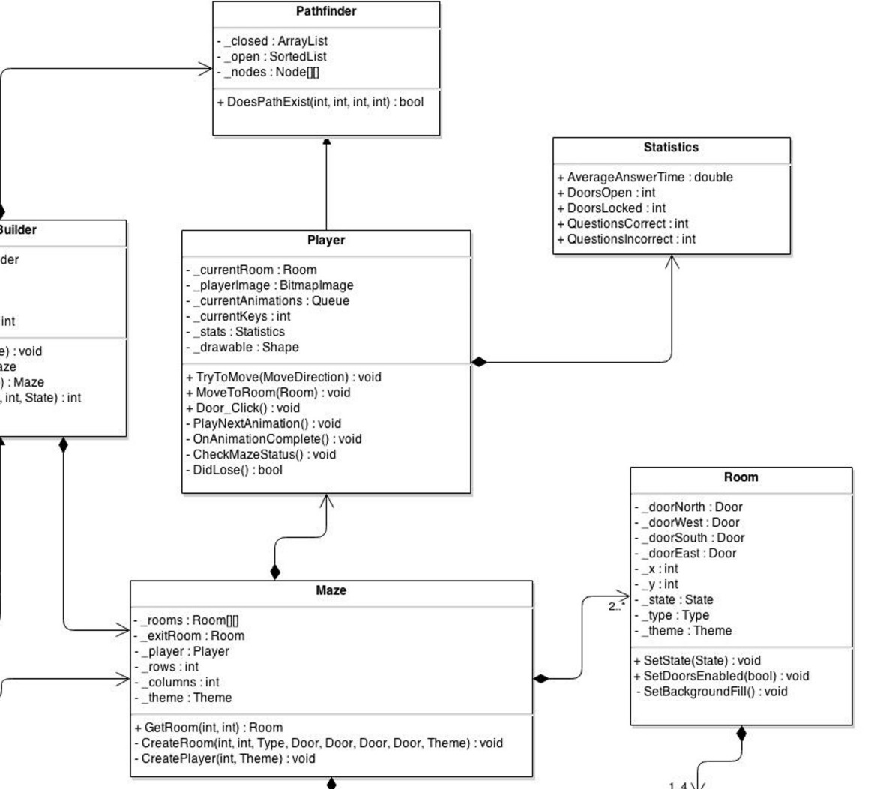
Class Diagram (cont.)

Slide 4
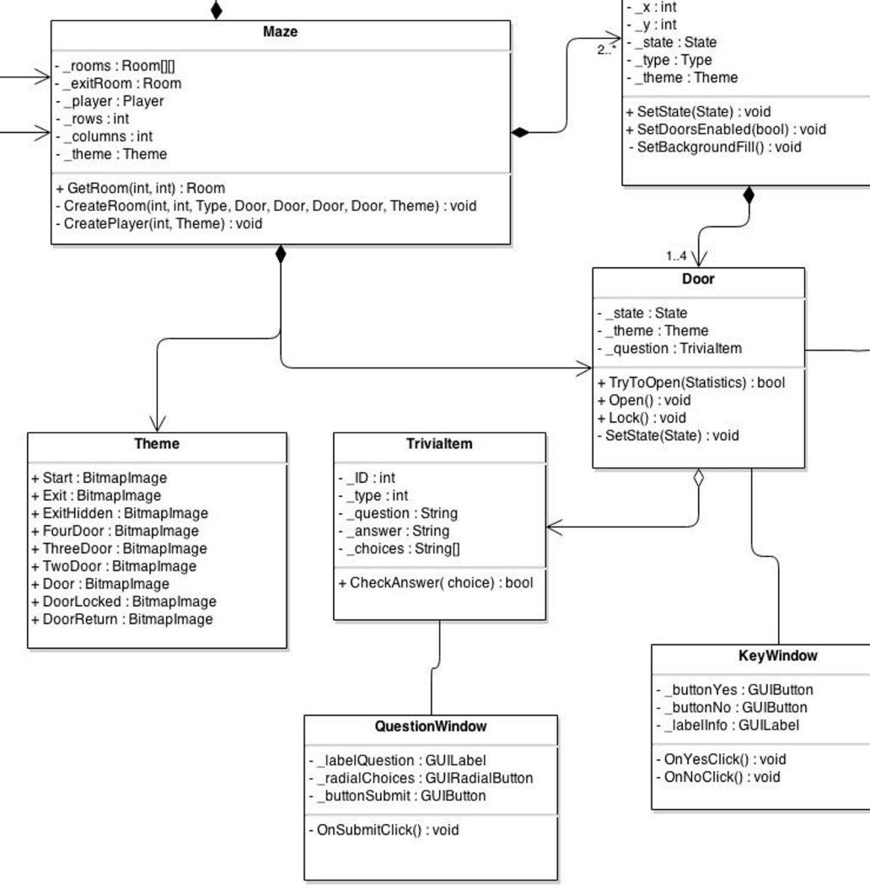
Class Diagram (cont.)

Slide 5
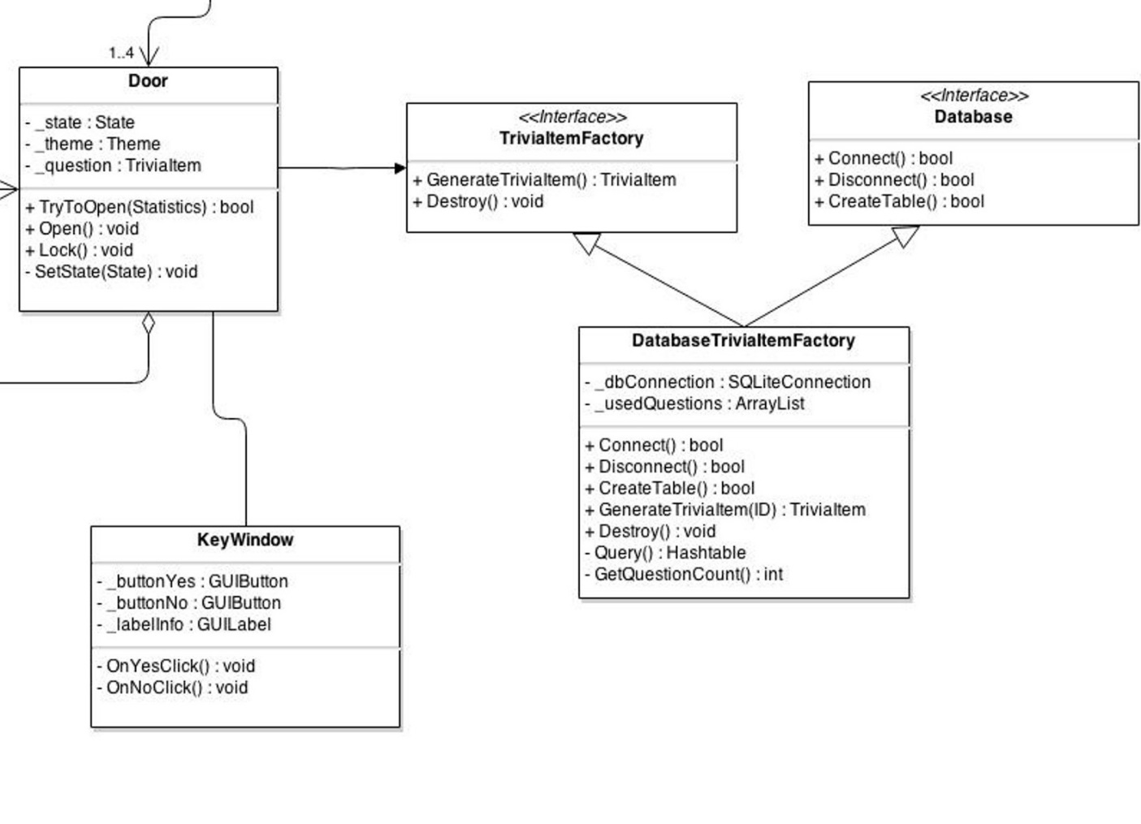
Class Diagram (cont.)

Slide 6
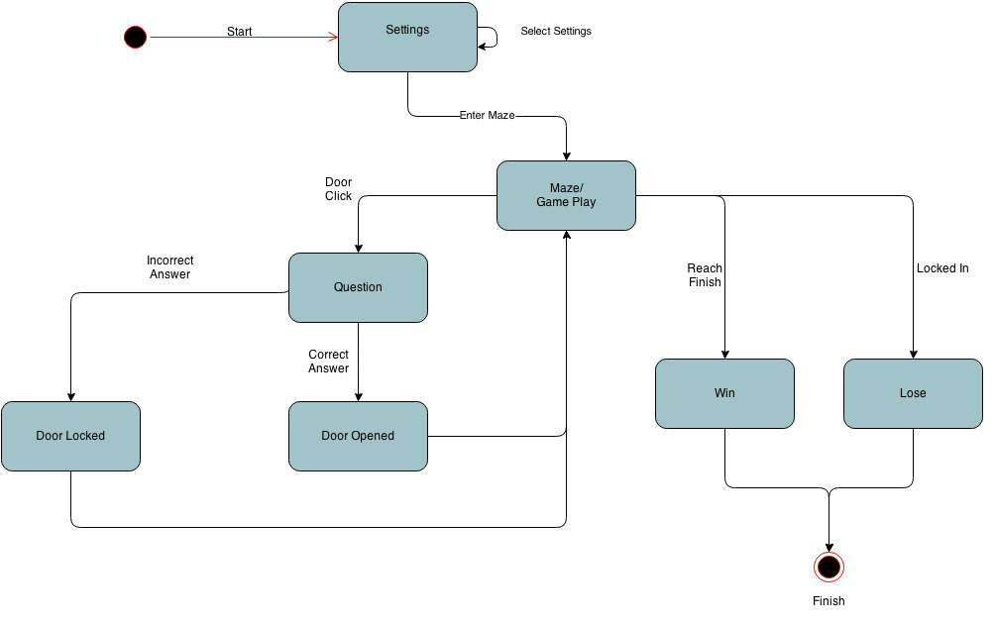
State Diagram

Slide 7
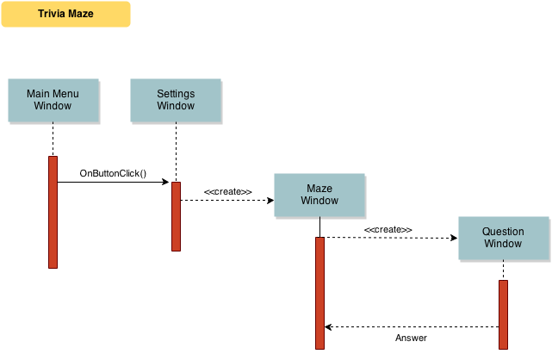
Sequence Diagram

Slide 8
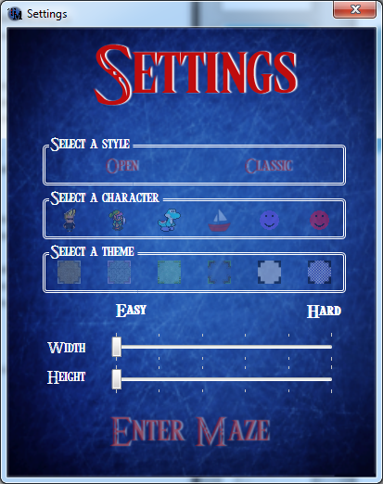
Settings
Maze Style
Character
Theme
Height
Width

Slide 9
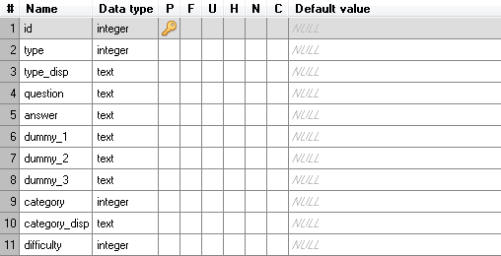
Database

Slide 10
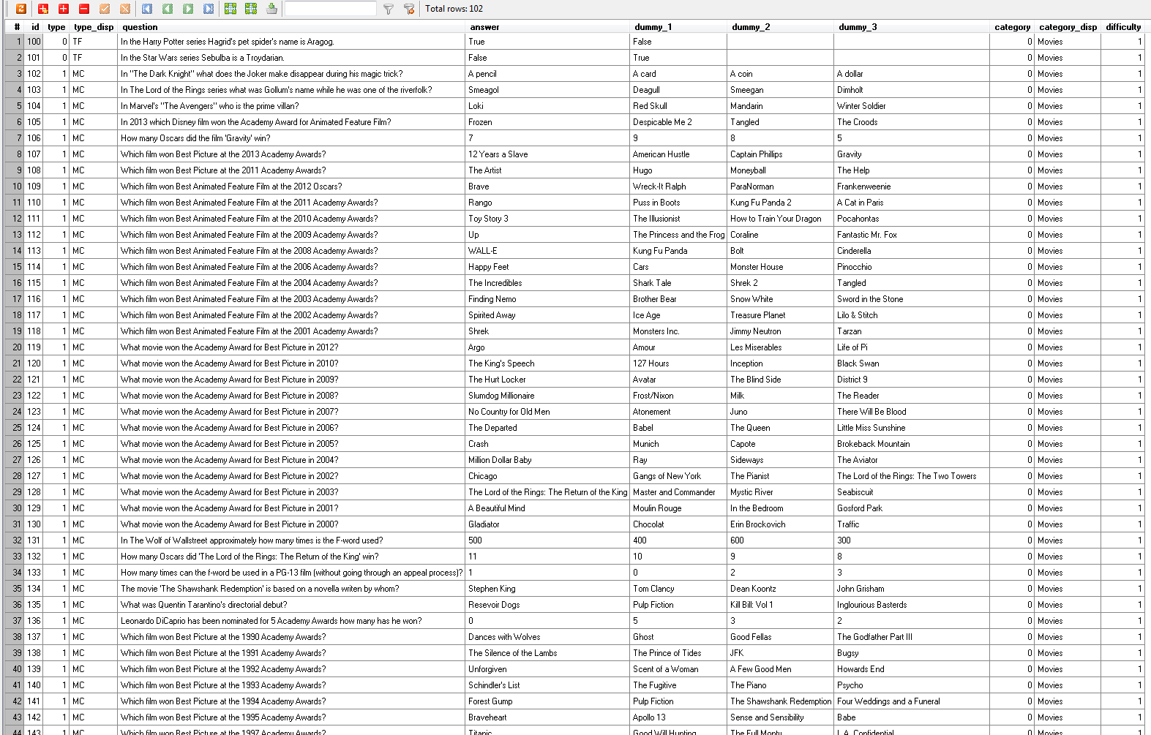
Database (cont.)

Slide 11
Database (cont.)
Questions are not repeated in a given game
There are enough questions for (almost) an 8 by 8 maze
Correct answers are shuffled around

Slide 12
Demo
Blue Team Trivia Maze

